Slide 2
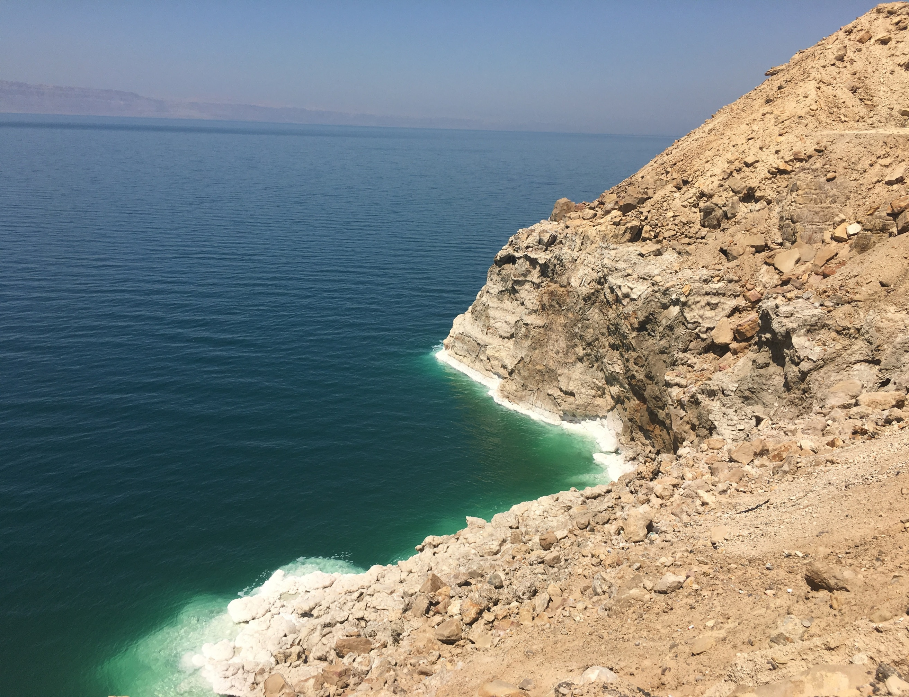
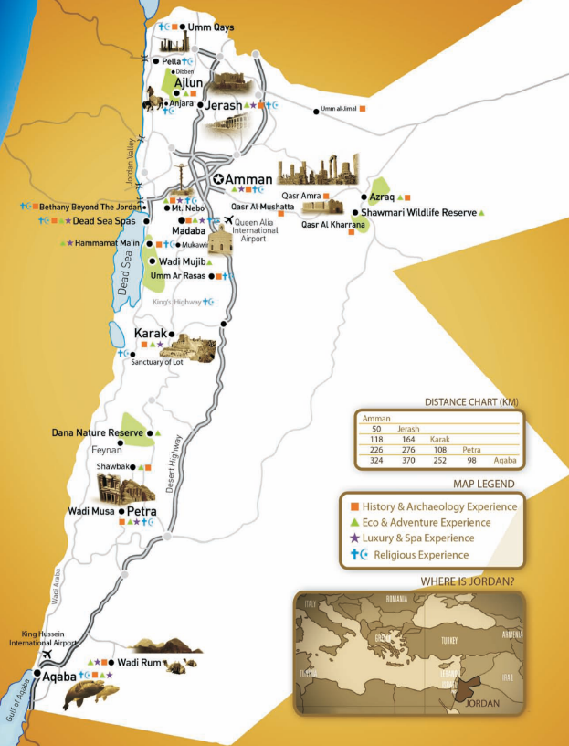
Jordan at a Glance
Capital City: Amman
Area: 37,138 square miles
Population: ~ 9 million
Language: Arabic, English

Slide 20
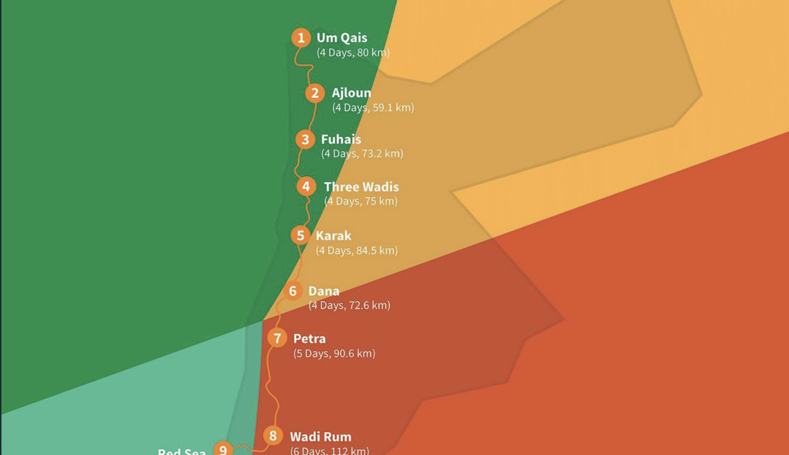

Slide 25
GoLocalJordan.com

