Slide 1
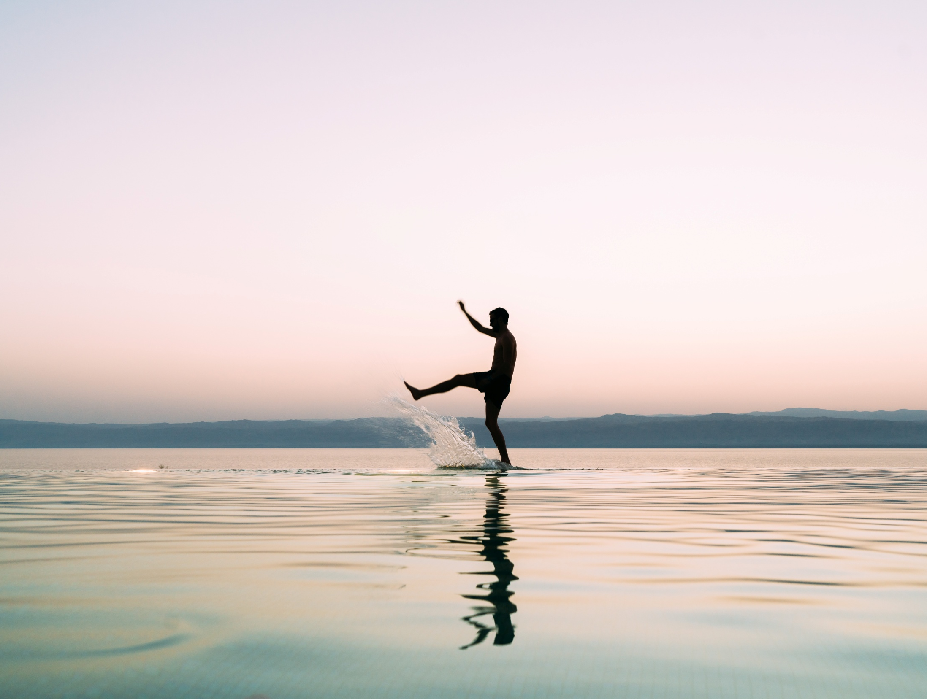
Jordan

Slide 2
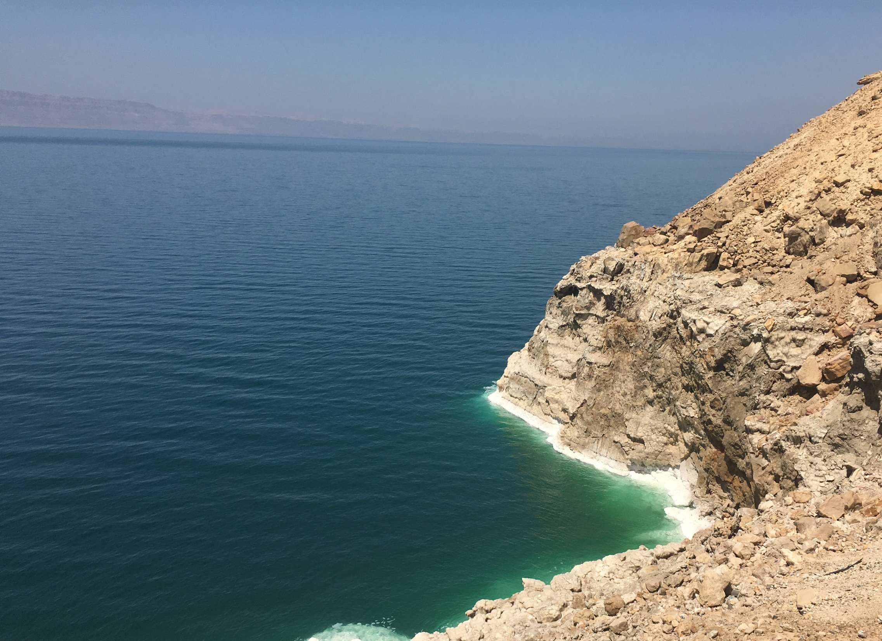
Ahlan Wa Sahlan… Welcome!
Jordan at a Glance
Capital City: Amman
Area: 37,138 square miles
Population: ~7 million
Language: Arabic, but English is widely spoken
Largest number of travelers are from the United States
Know as “Switzerland of the Middle East”

Slide 3
Ease of Entry
Uniform Visa Fees for all nationalities: Visa Forms Online:
Single Entry = 1 month: 40 JOD/56 USD  www.jordanembassy.us
Double Entry = 3 months: 60 JOD/85 USD  Visitjordan.com
Multiple Entry = 6 months: 120 JOD/170 USD
Visas Upon Arrival!

Slide 4
Who’s Going to Jordan?
Jordan Research Study
Did you know?
Travelers Interested in the Middle East vs. Not Interested
Spend more
79% vs. 67% have passports
58% vs. 36% traveled internationally in last 12 months

Slide 5
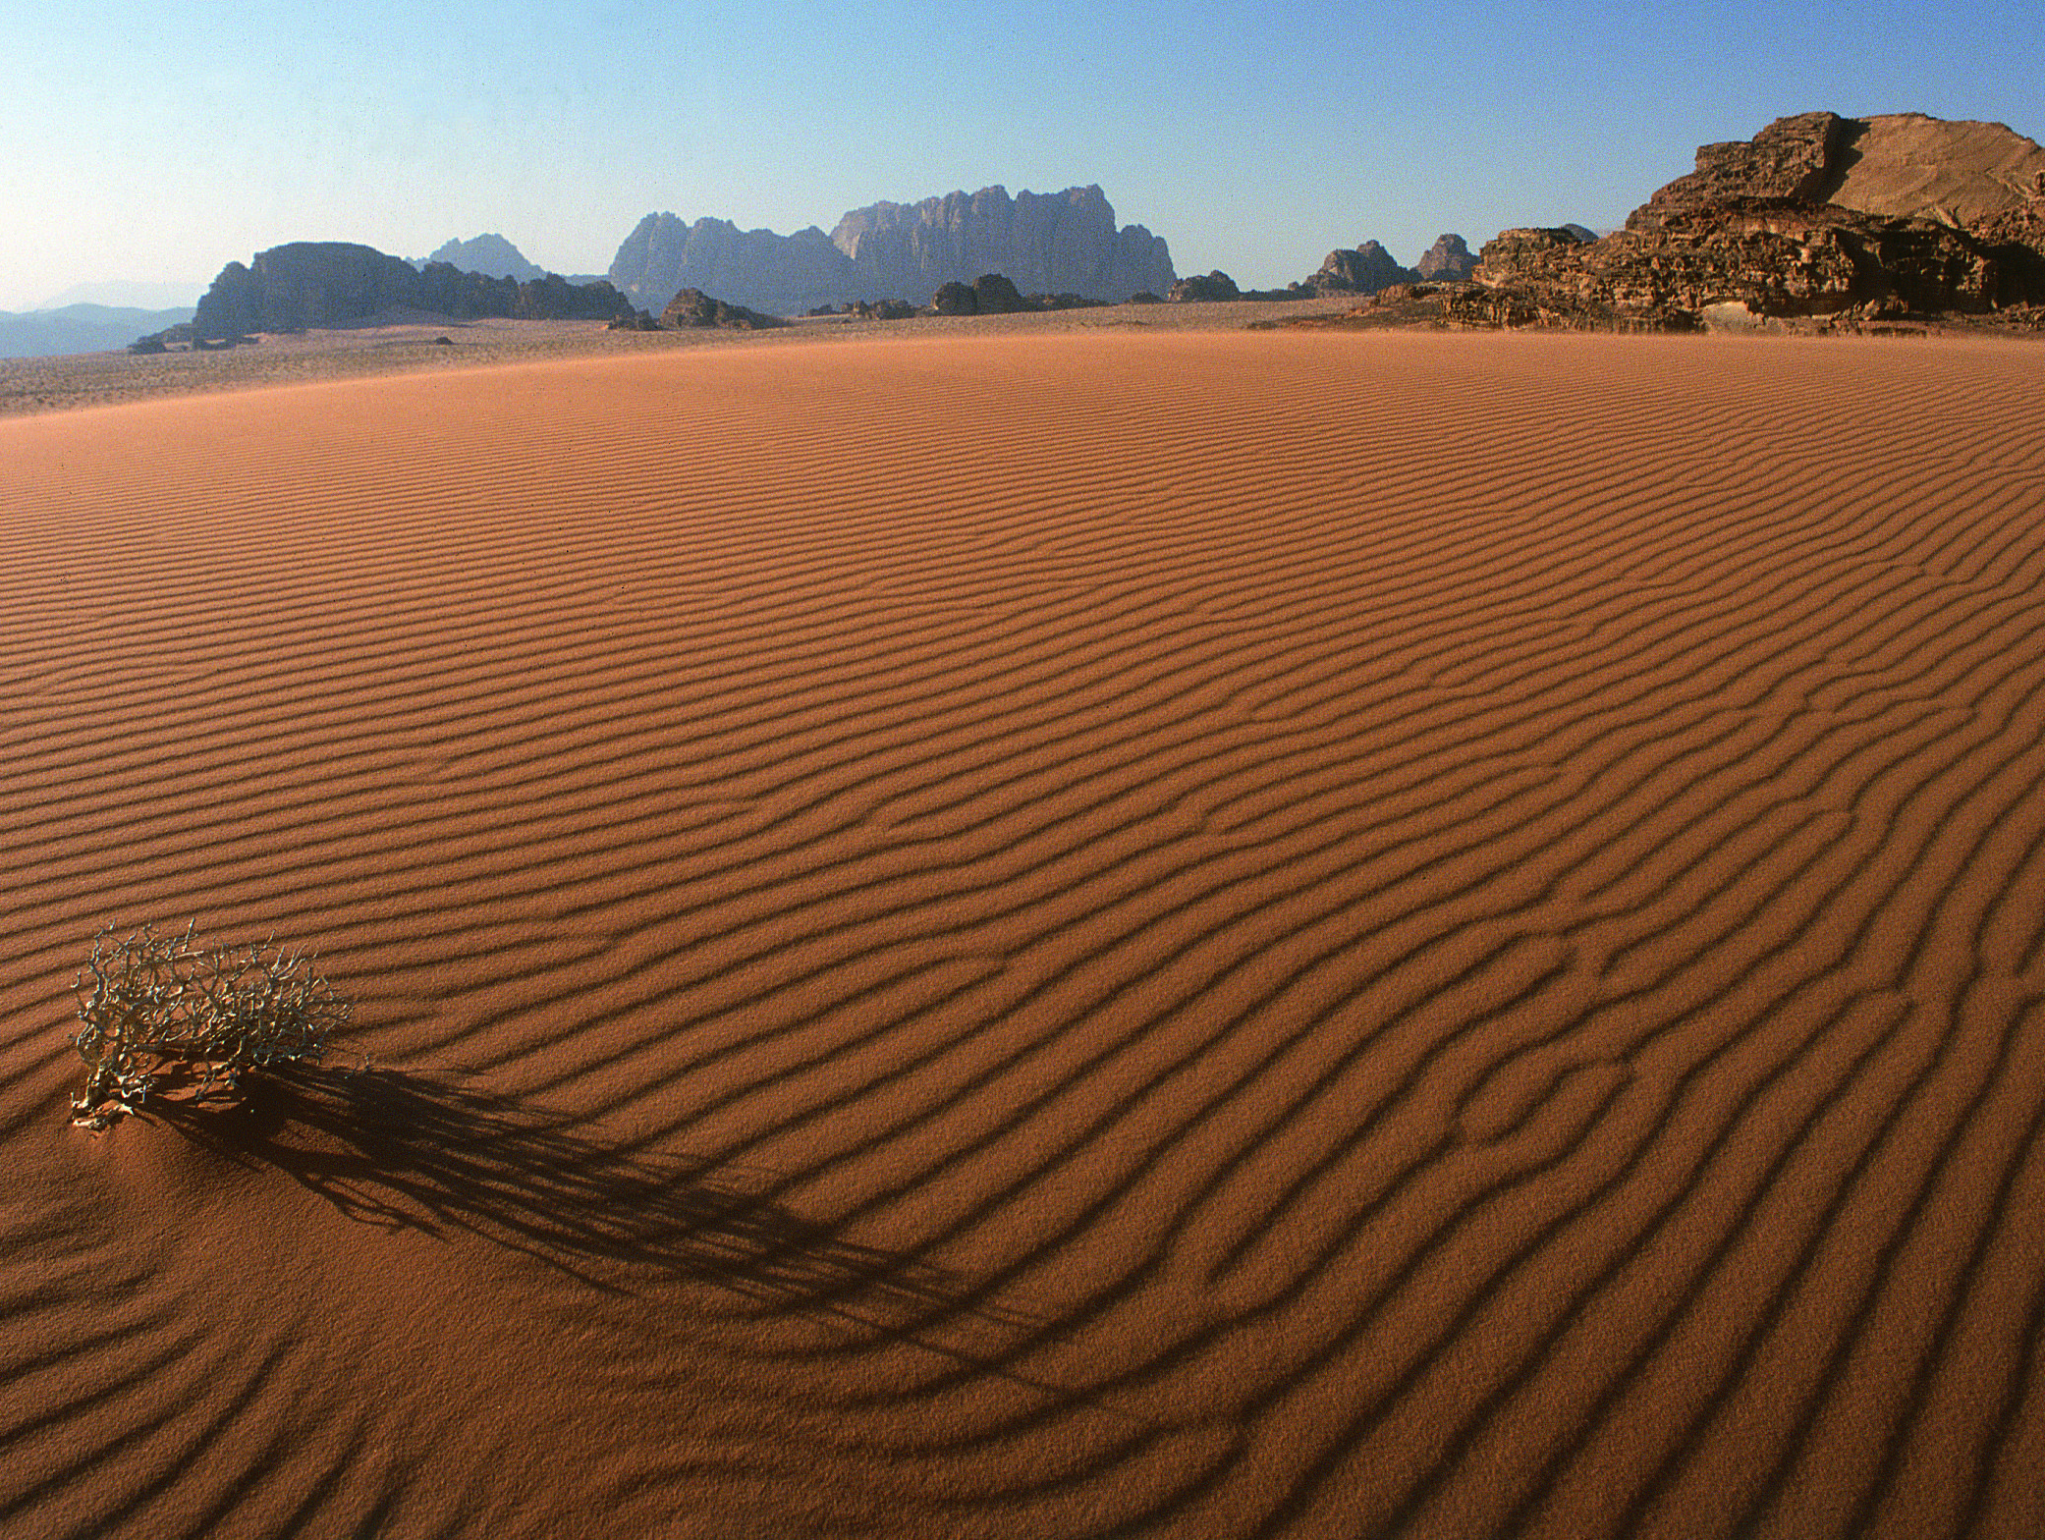
Insights on Travel to Jordan
After history & culture, leisure & wellness is the biggest draw
Travelers interested in the Middle East are also much more interested in tours with access to local experiences that would otherwise be unobtainable than those not interested in the regions – 73% vs. 52%

Slide 6
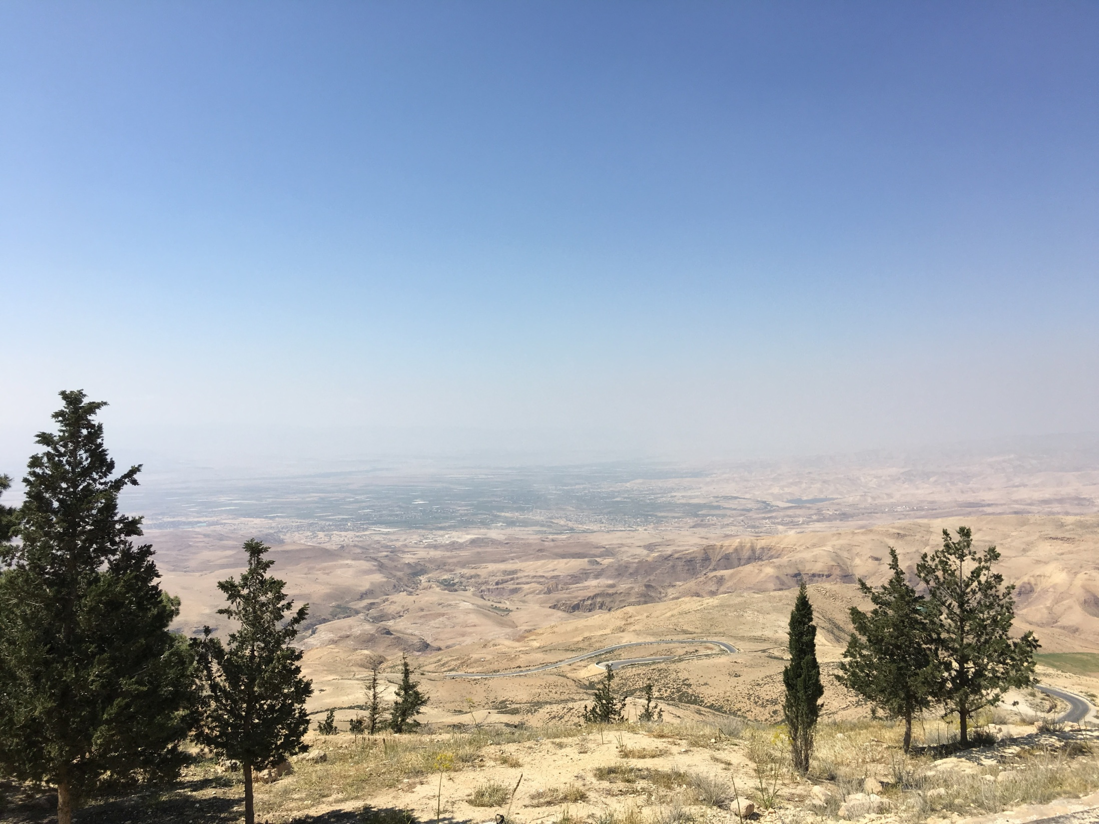
Roadblocks: Awareness & Perception of Safety
Reassurance of safety
73% of travelers not initially interested in visiting Jordan simply don’t know enough about Jordan to want to go there
Of those interested in visiting Jordan, only 53% were aware of Dead Sea resorts & spas – after reading a description, 94% were interested
Notes:
Reassurance: refugee camps are far from tourist sites, tourist police

Slide 7
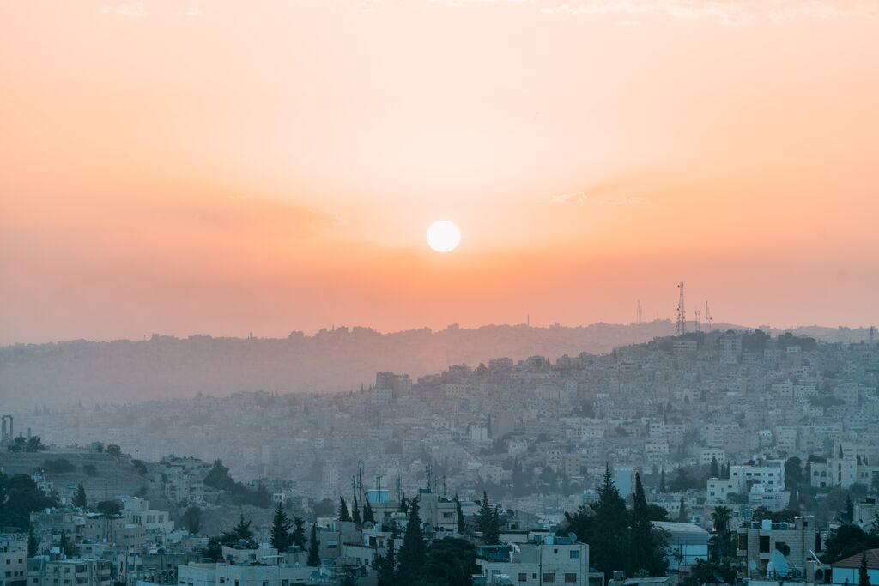
Amman
A unique blend of old and new

Slide 8
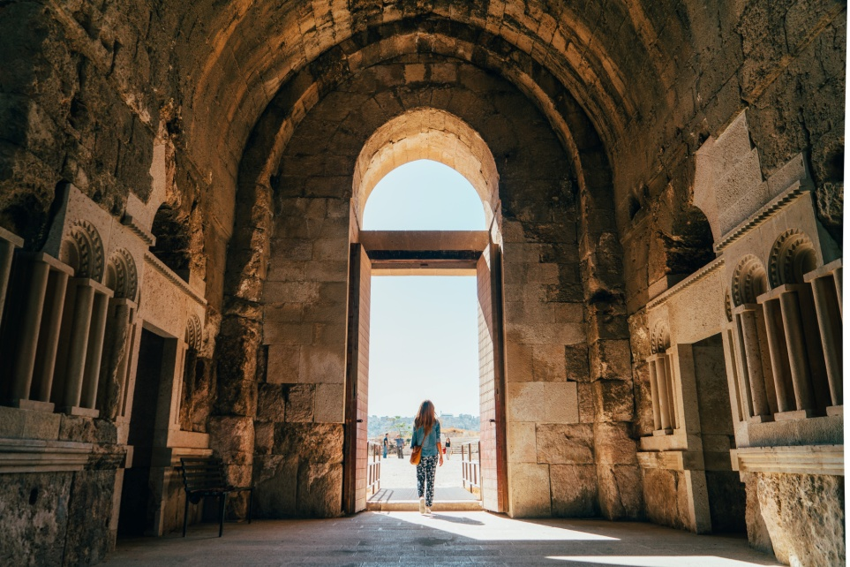
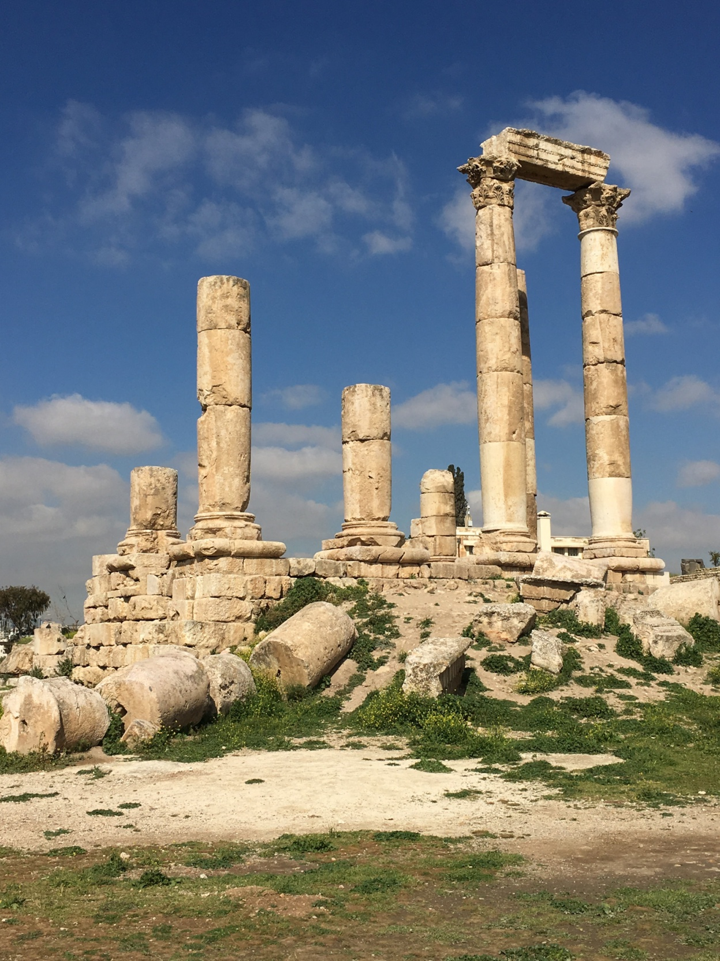

Slide 9
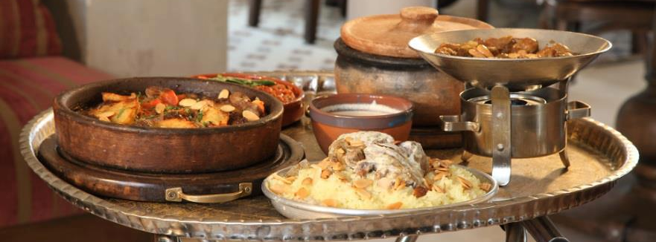
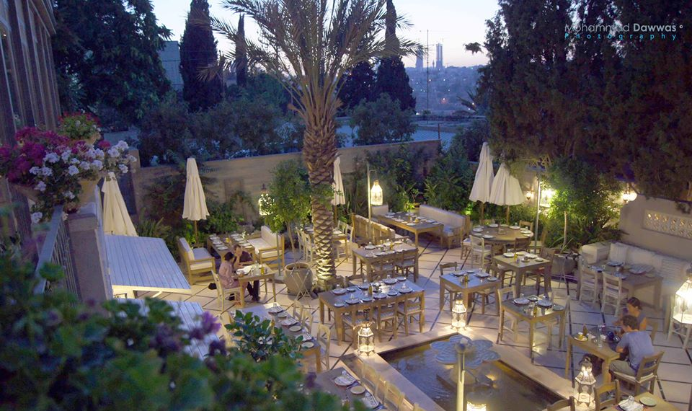
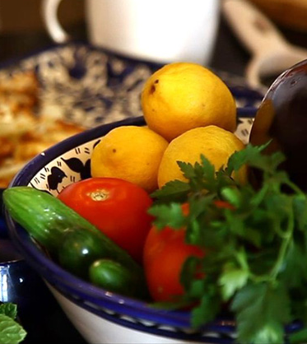

Slide 10
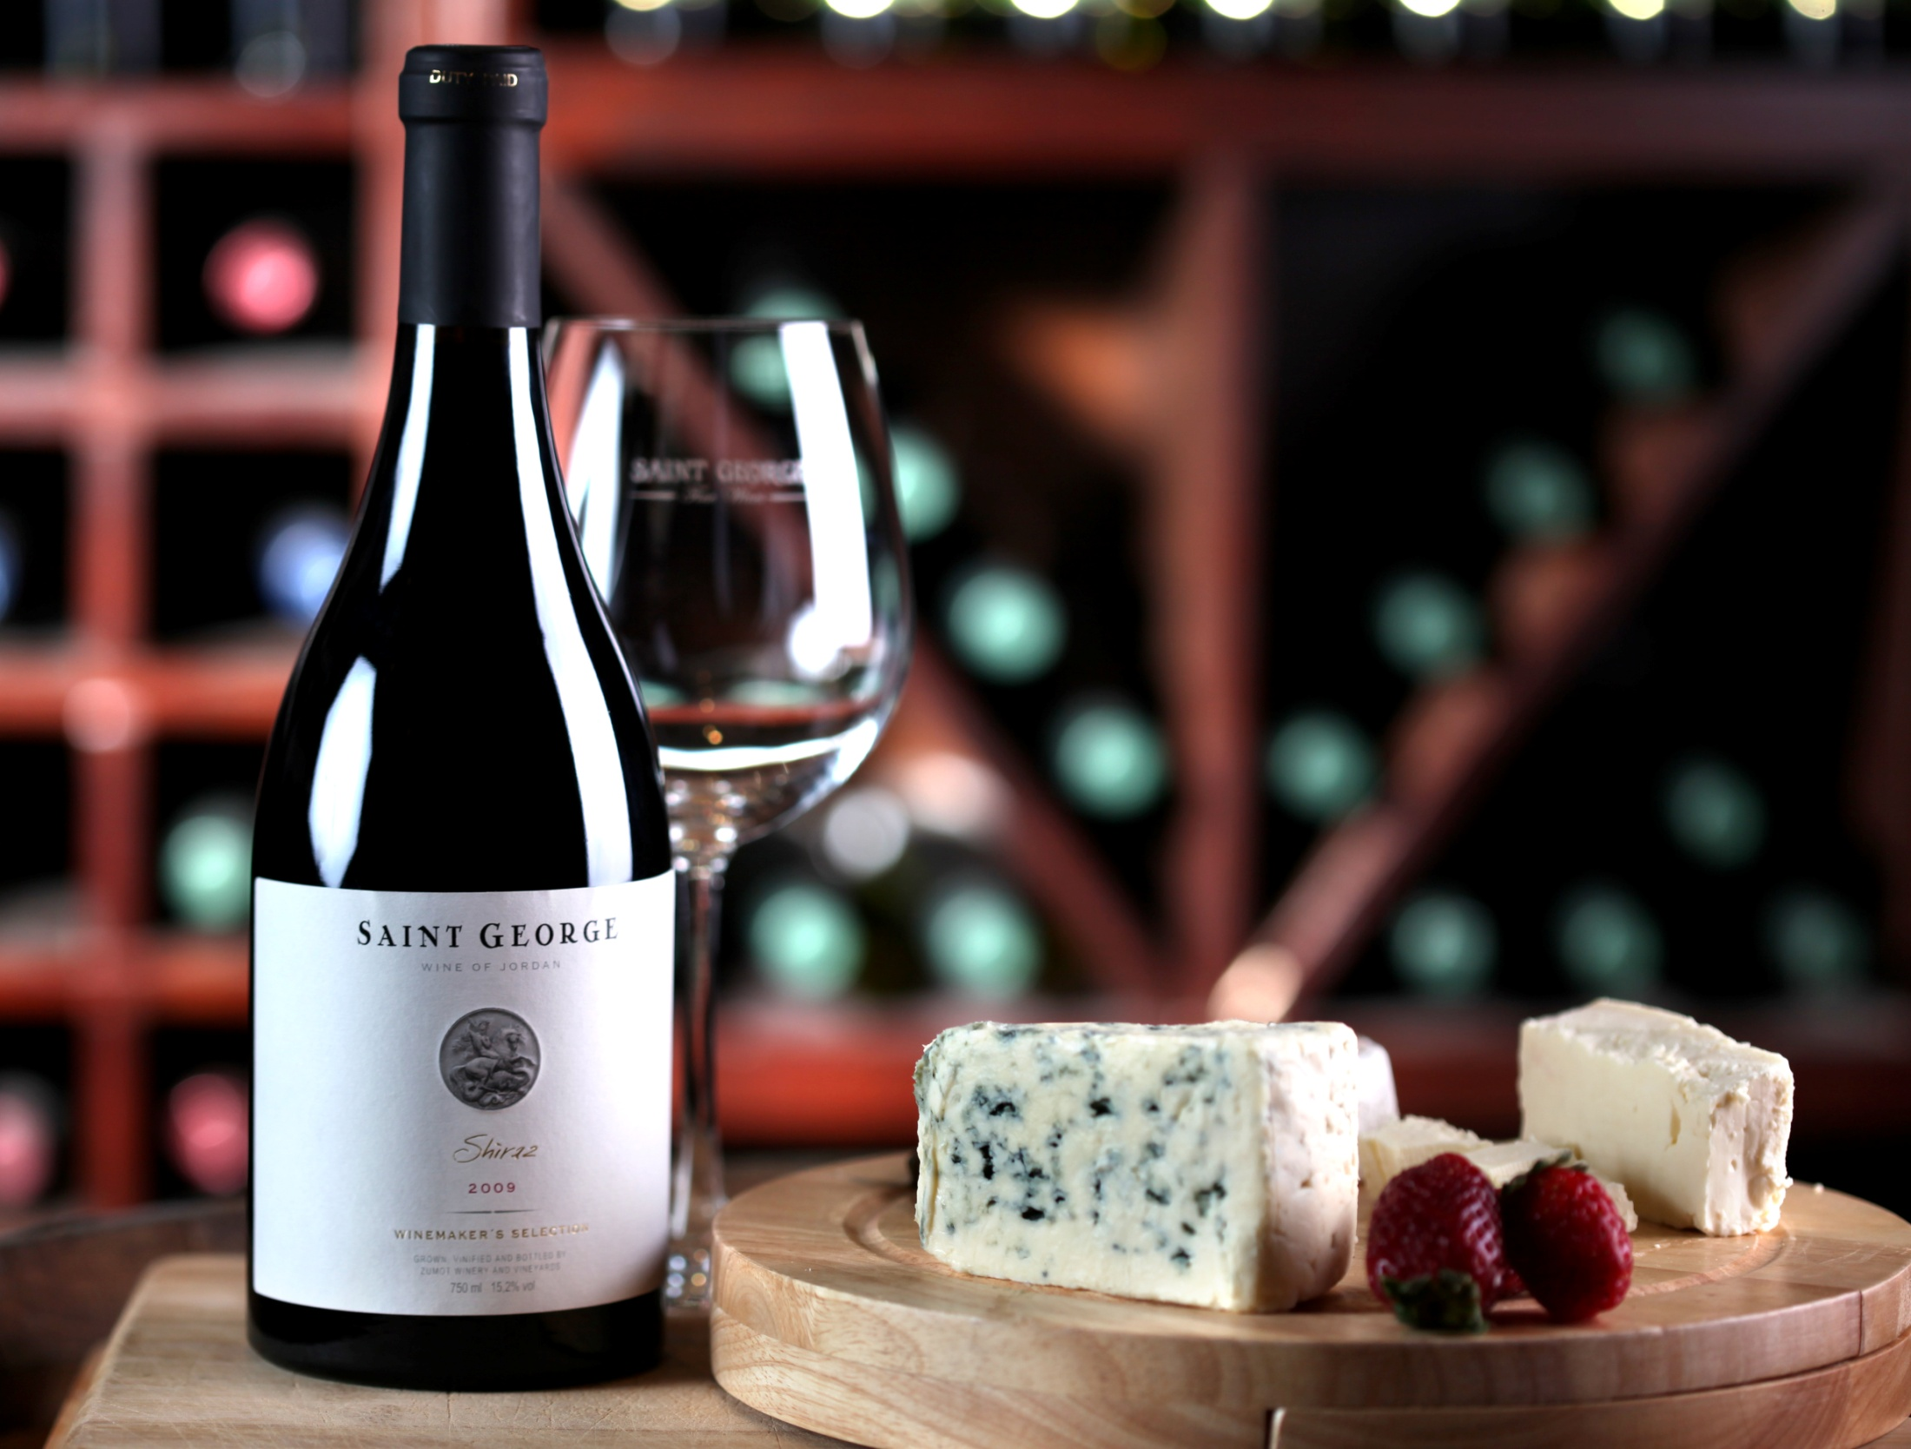

Slide 11
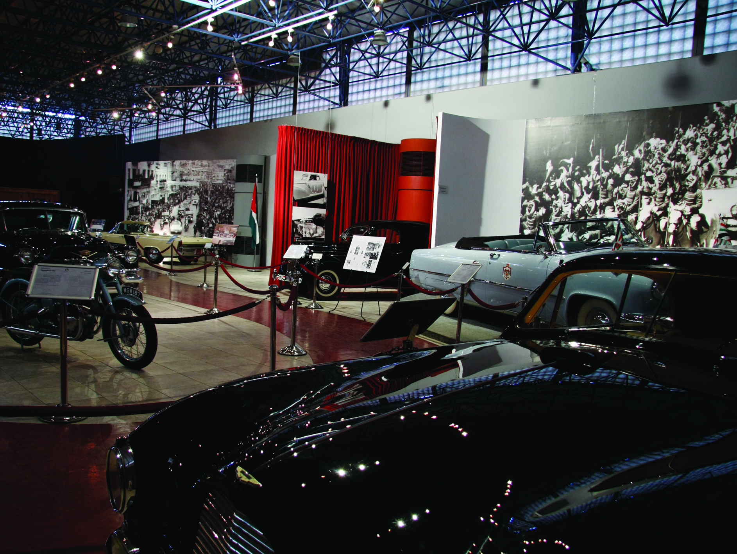

Slide 12
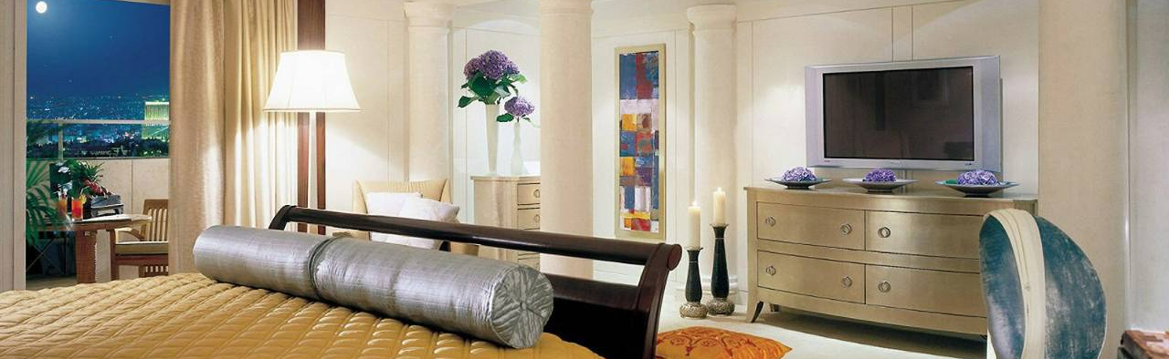
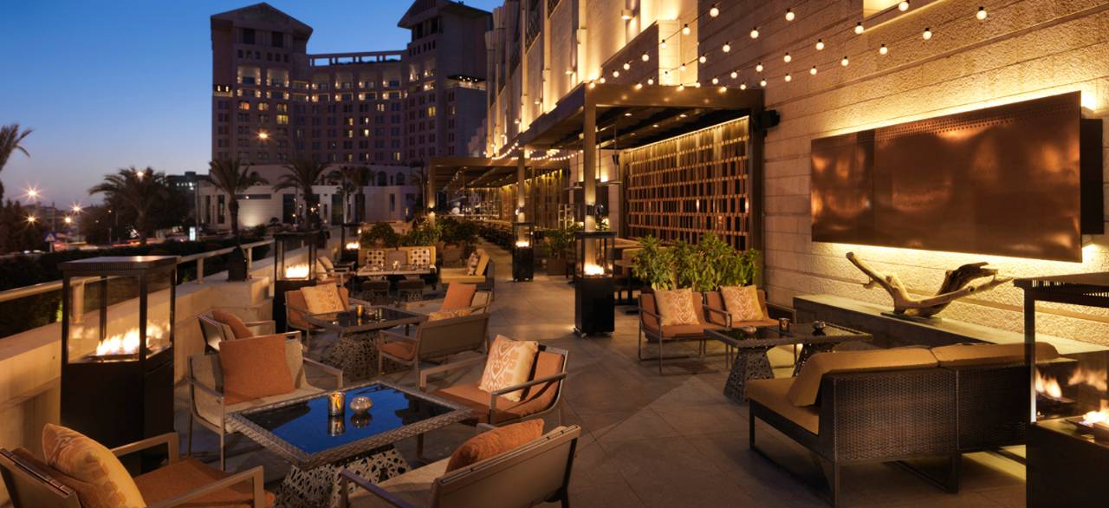

Slide 13
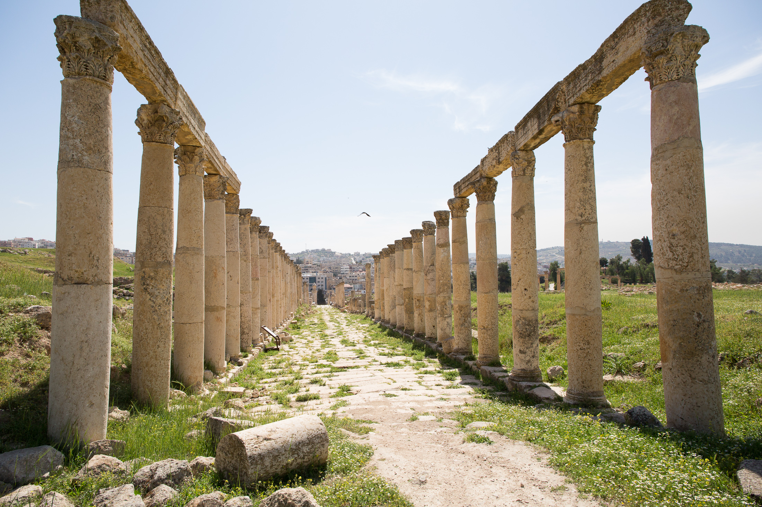
Jerash
The Crossroads of Civilization

Slide 14
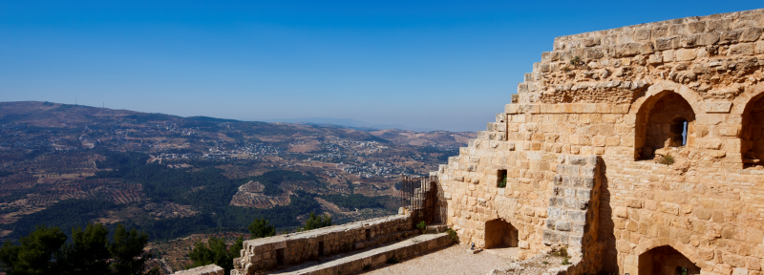
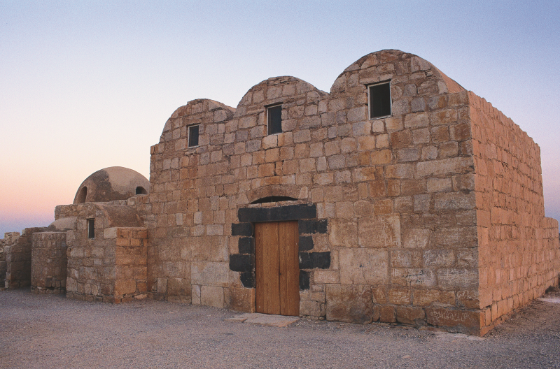
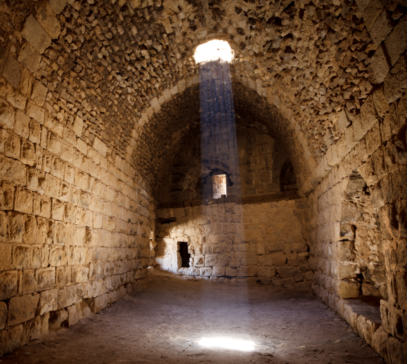
Castles

Slide 15
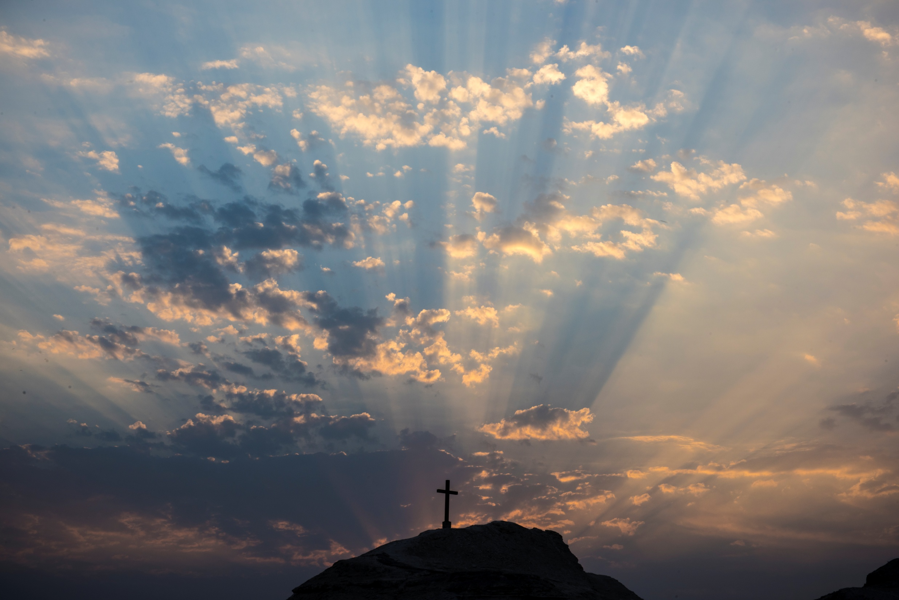
Bethany Beyond the Jordan
Mount Nebo
Madaba
The Holy Sites of Jordan

Slide 16
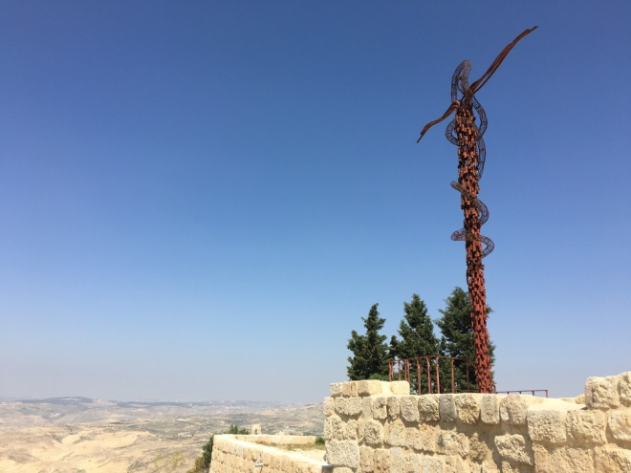
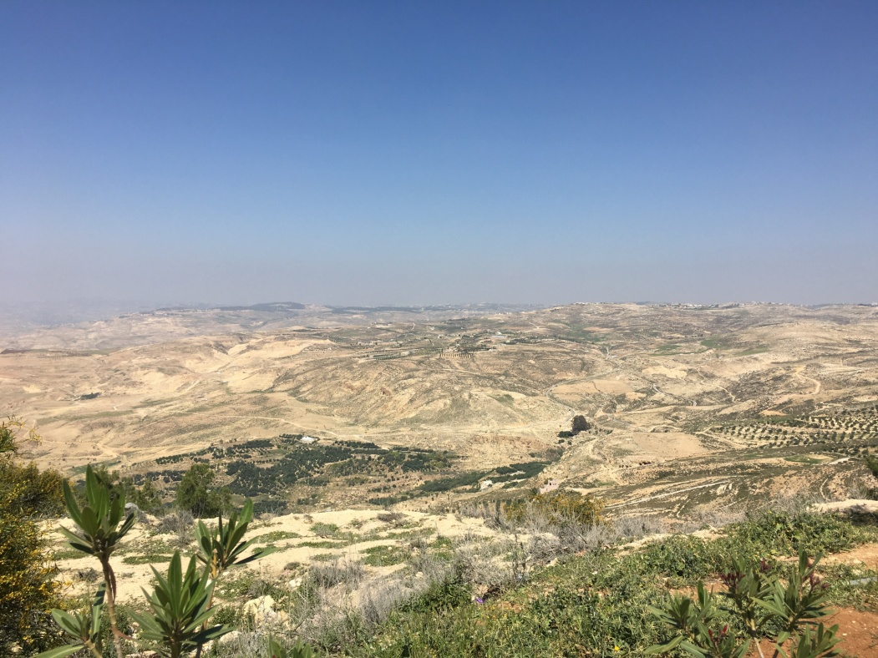
Mount Nebo

Slide 17
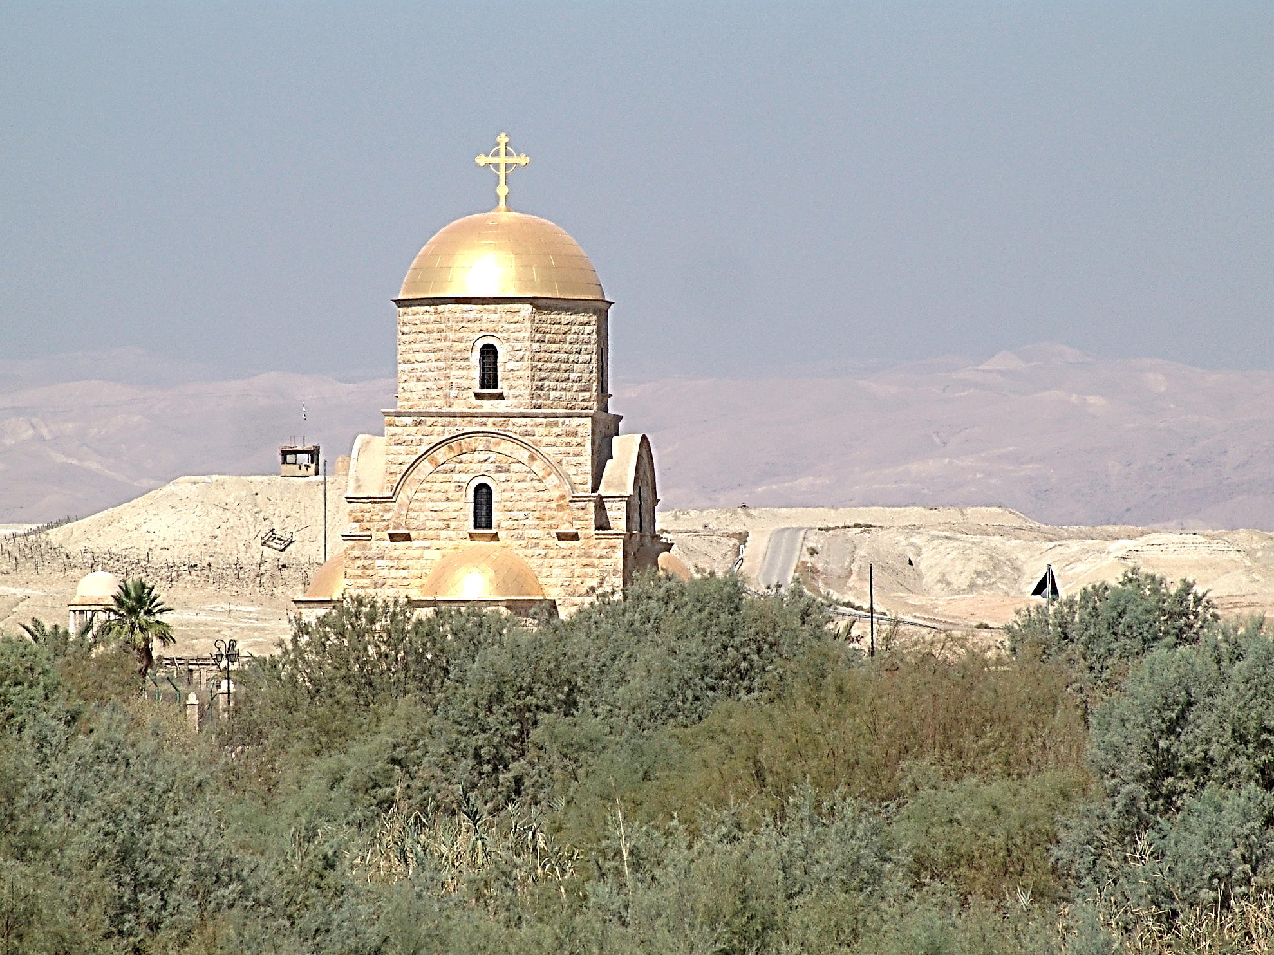
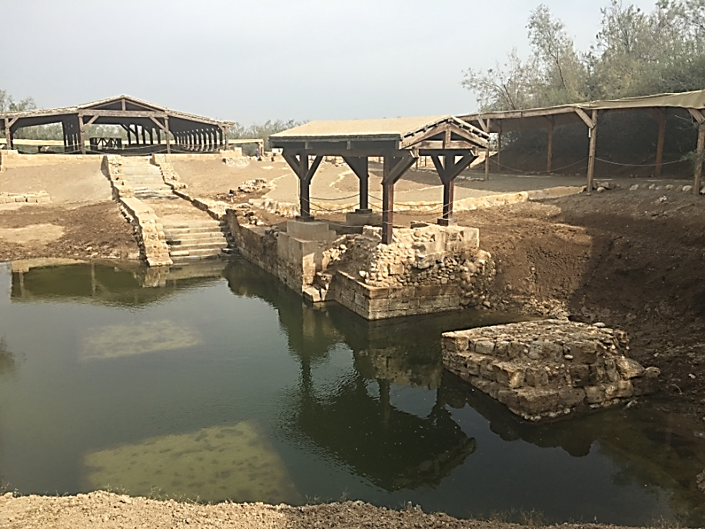
Bethany Beyond the Jordan

Slide 18
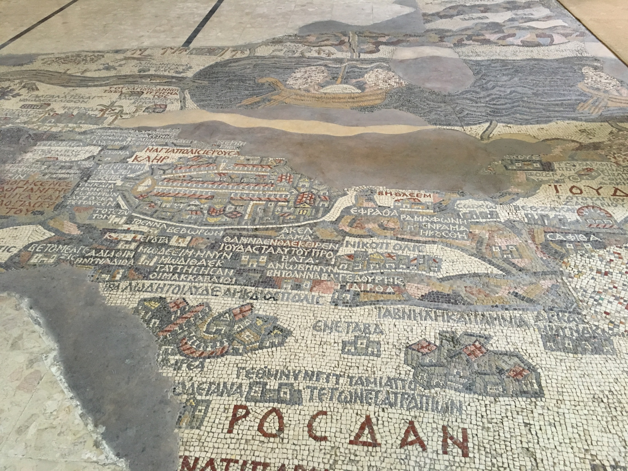

Slide 19
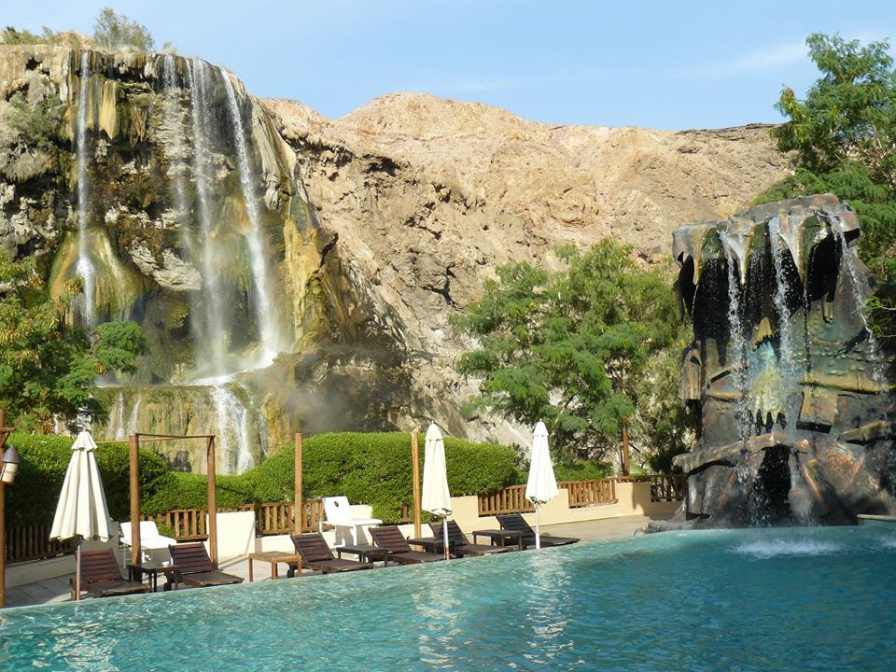
Ma’in Hot Springs

Slide 20
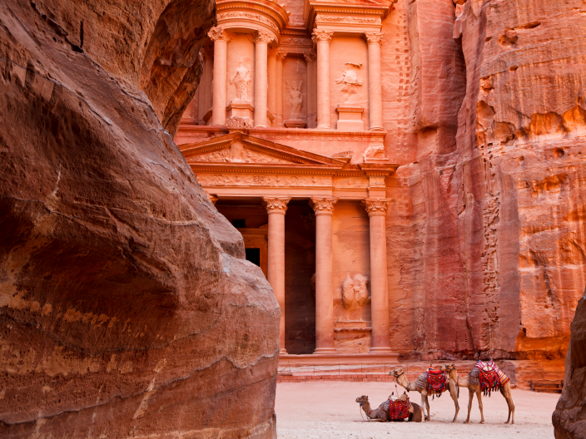
Petra
A UNESCO World Heritage Site and one of the New Seven Wonders of the World

Slide 21
Petra
By Night

Slide 22
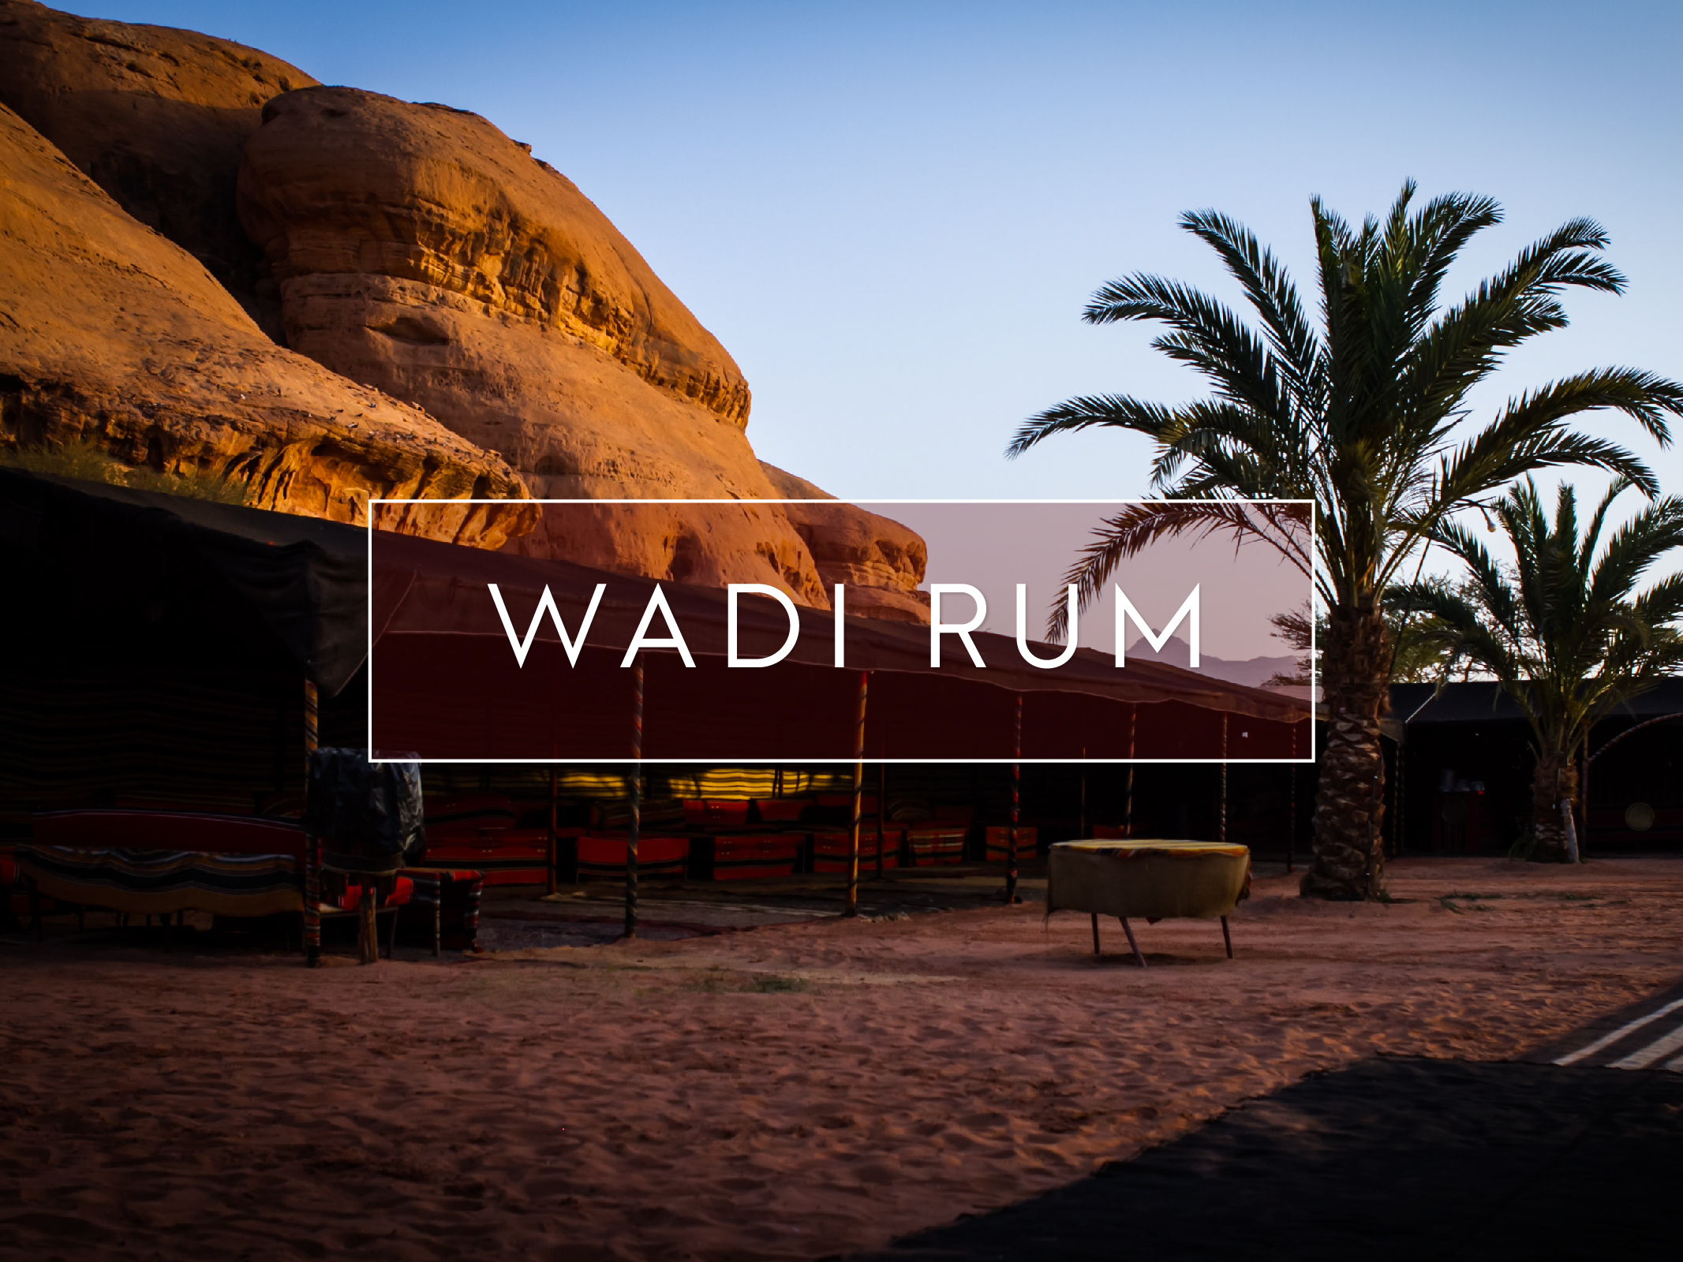

Slide 23
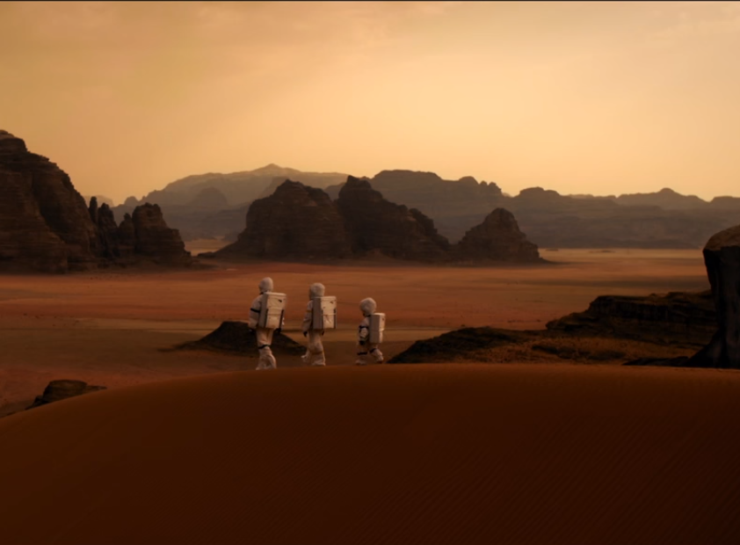
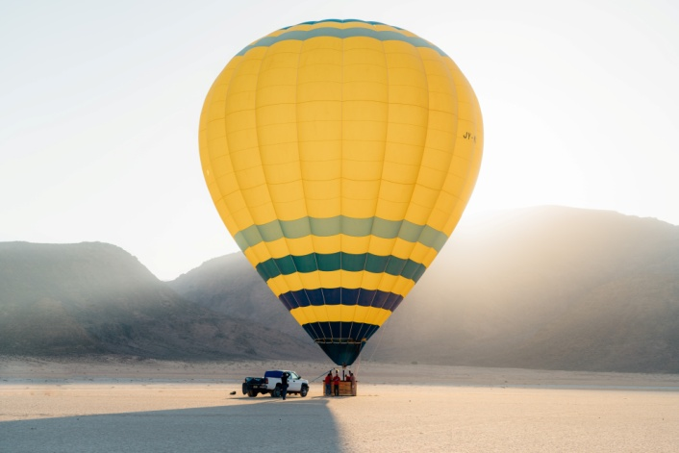
Wadi Rum, known as the Valley of the Moon, was the filming location for “The Martian”

Slide 24
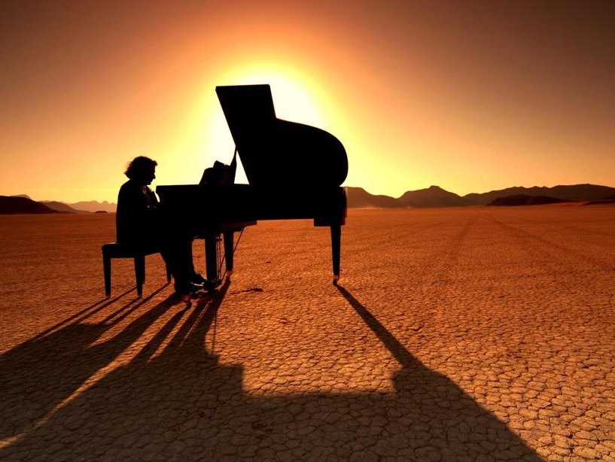
Special Evenings with Spectacular Backdrops

Slide 25
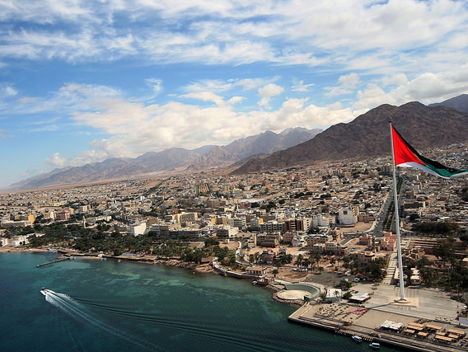
Aqaba

Slide 26
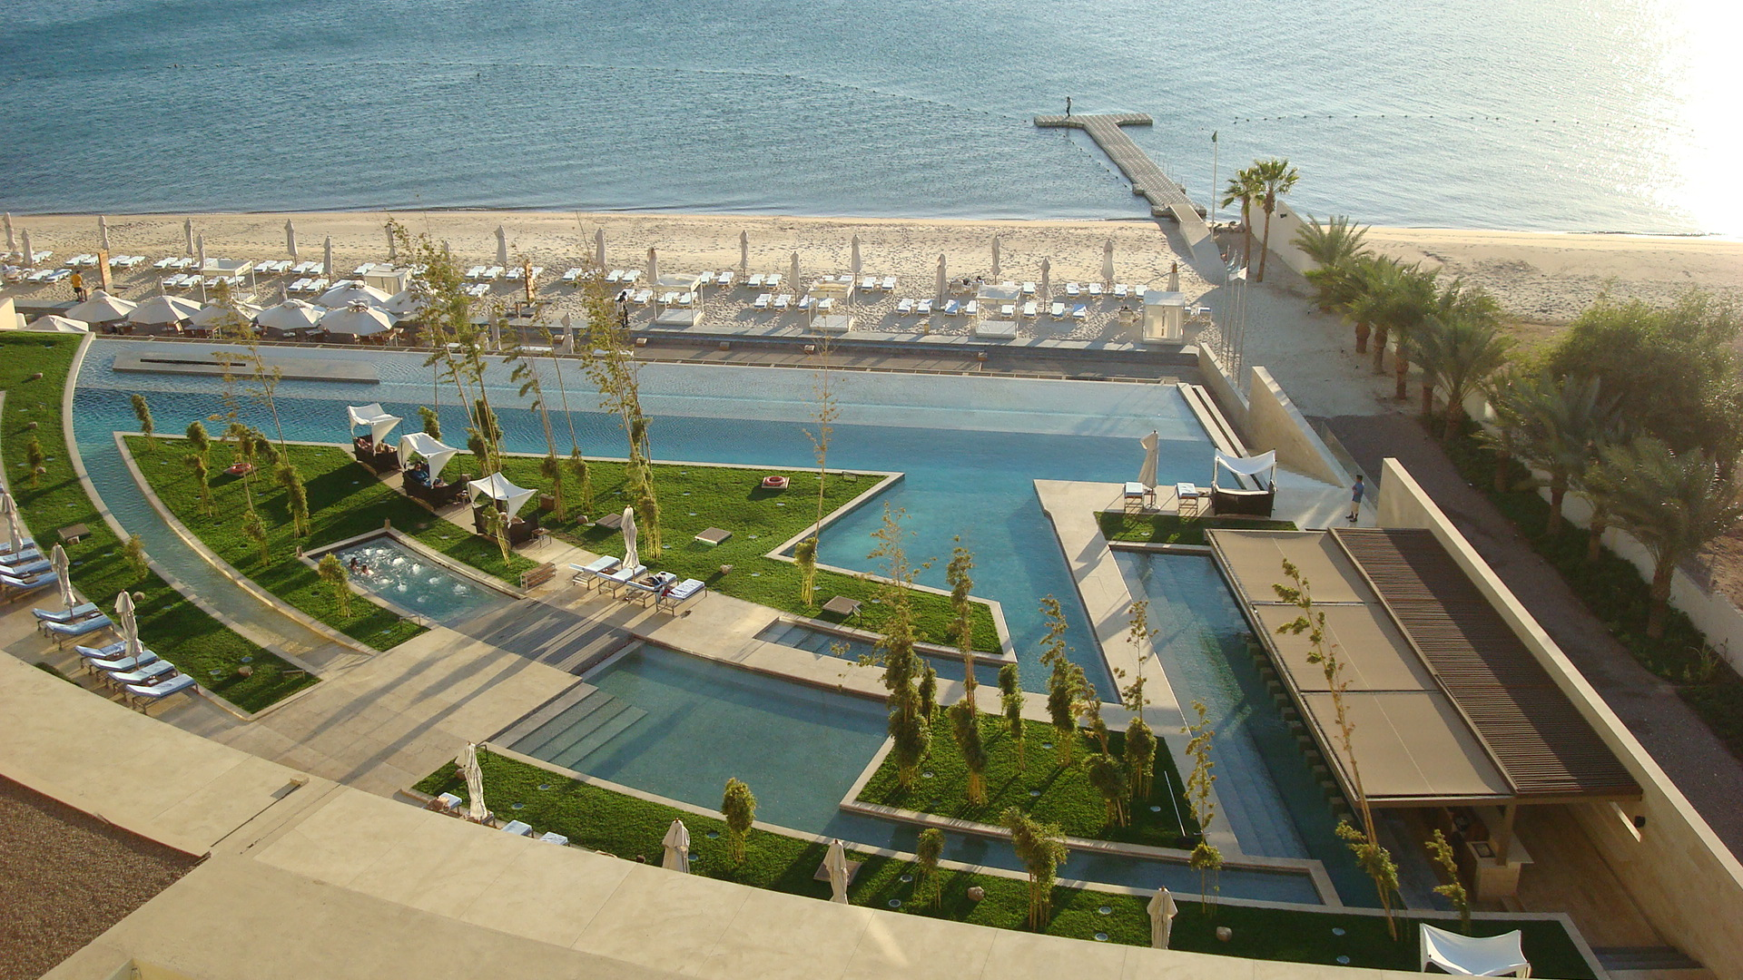

Slide 27
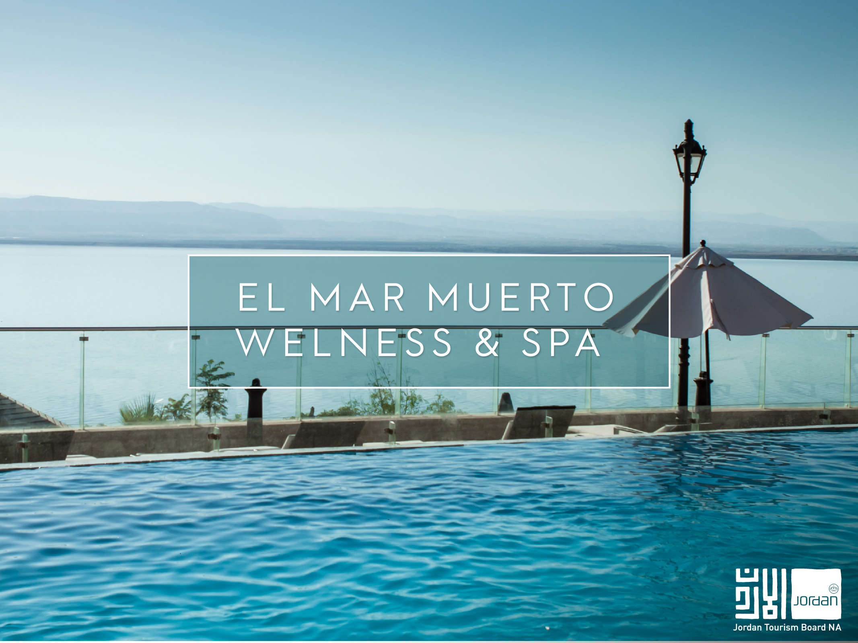
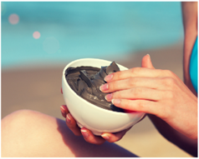
The Dead Sea
The Dead Sea
Wellness & Spa

Slide 28
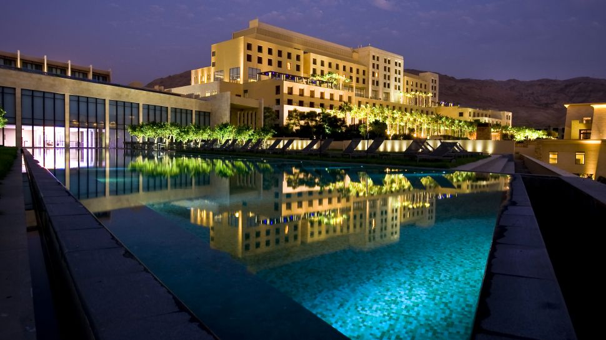
Kempinski Ishtar Dead Sea

Slide 29
Special Evenings with Spectacular Backdrops

Slide 30
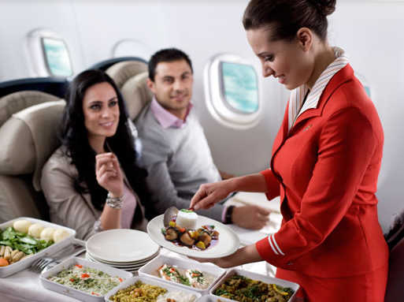

Slide 31
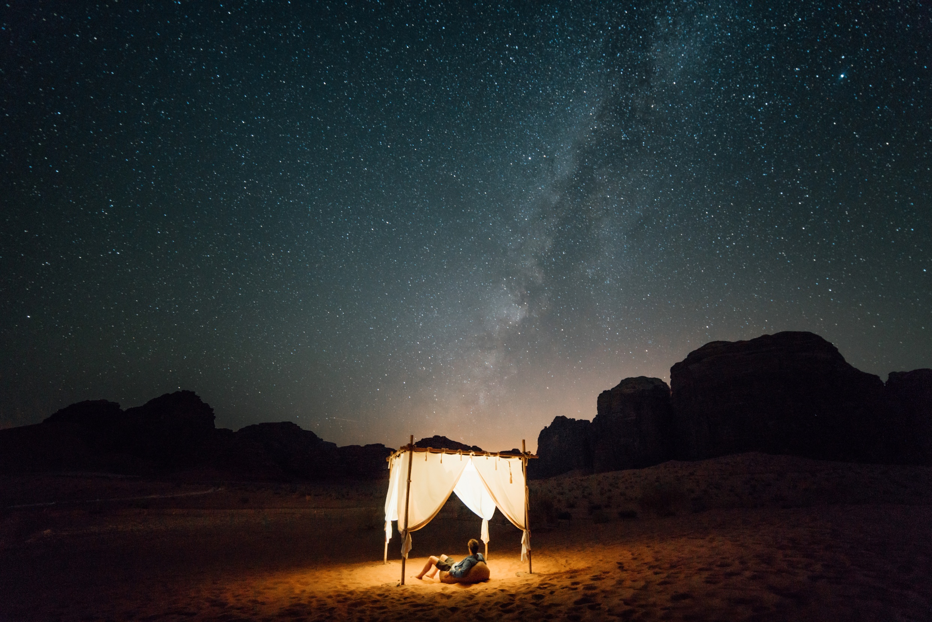
Questions?

Slide 32
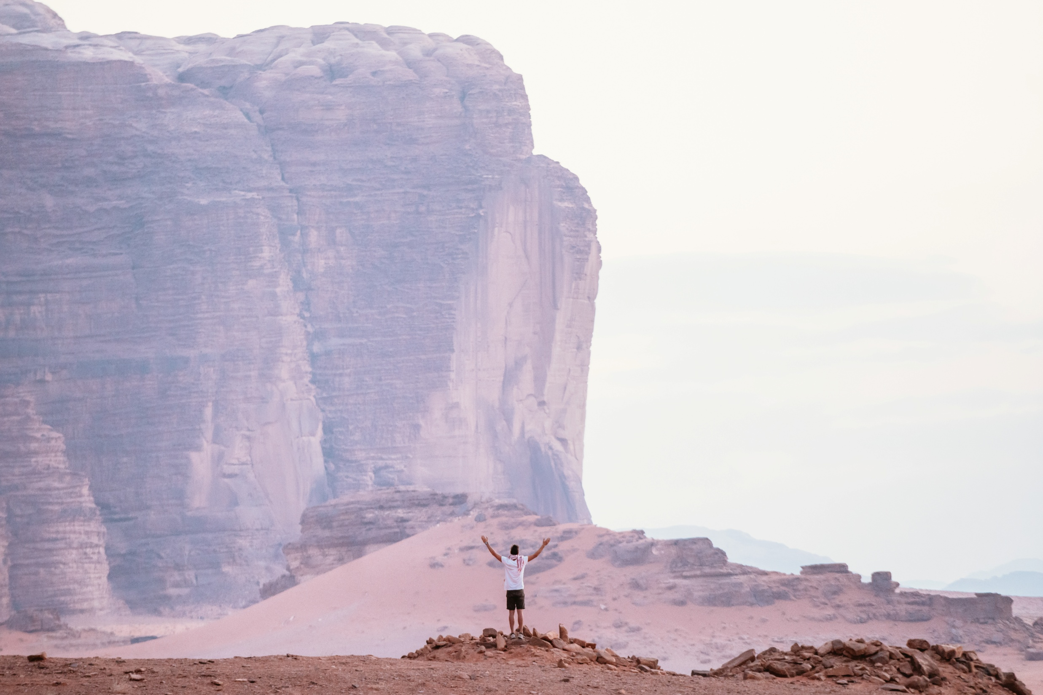
Thank You!
Shukran!
Email: contactus@visitjordan.com
www.visitjordan.com

